Slide 1
Assembly Committee on Communications & Conveyance
John Reynolds, President, CPUC
March 11, 2026

Slide 2
Modernizing and Expanding Connectivity: Access to Essential Service
Public Safety and Carrier Oversight
- License companies, oversee compliance, and address consumer complaints
- Service quality standards to protect consumers and ensure reliable service, including timely restoral, compensation for outages, and enforcement for poor performance
Universal Service
Public Purpose Programs ensure affordability, equity, and access:
1. California LifeLine Program
2. California Teleconnect Fund
3. California Connect (DDTP)
4. California Advanced Services Fund
5. California High-Cost Fund A
6. California High-Cost Fund B
Carrier of Last Resort obligation ensures access.
Broadband Deployment and Adoption
Develop, implement, and administer three major broadband deployment program:
(1) California Advanced Services Fund
(2) Federal Funding Account
(3) Broadband Equity Access and Deployment
- Network resiliency rules (e.g., backup power) ensure disaster preparedness.

Slide 3
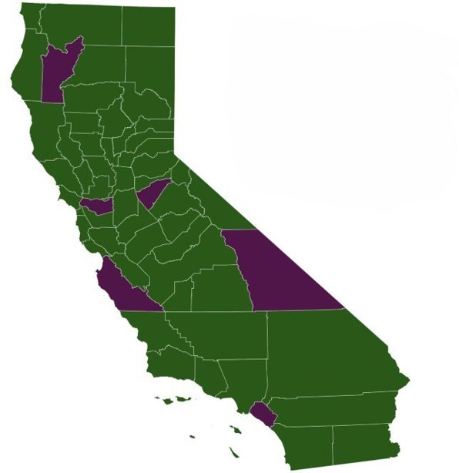


Last Mile Broadband Deployment Grants Are Connecting Communities
106 Technical Assistance planning grants
122 Federal Funding Account Projects
Across California
  $1.23 billion in grants awarded
  58 counties with awarded grants
  2.1 million Californians benefitting from investments
  4,000 Community Anchor Institutions benefitting
  7,500 fiber miles deploying
  120 projects include an affordable broadband offer

Slide 4
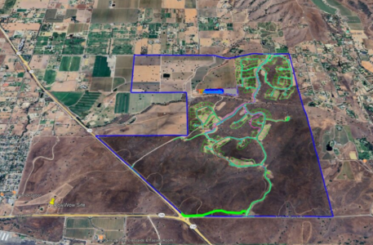
The Chumash Fiber Network
With a broadband infrastructure grant from the CPUC Federal Funding Account, the Santa Ynez Chumash are building a resilient high-capacity underground fiber optic network that will offer up to five gigabits per second (Gbps) symmetrical service to residents within Chumash Tribal Lands and benefit the surrounding population.
The Chumash Fiber Network spans roughly 13 miles of underground fiber through more than 1,400 acres of ranch land.
The project leverages California's open-access Middle Mile Broadband Initiative (MMBI) to upgrade existing backhaul infrastructure and support the new network traffic.

Slide 5
Broadband Equity Access and Deployment (BEAD)
Proposed Awards by Technology Type
Technology Type | Total Preliminary Awards | Total Locations | Percentage of Total Locations | Total Funding Amount | Percentage of Total Funding Amount
Fiber | 68 | 147,308 | 43.5% | $1,357,171,197 | 86.2%
Hybrid | 3 | 3,285 | 1% | $3,030,809 | 0.2%
Licensed Fixed Wireless | 11 | 48,204 | 14.2% | $44,887,759 | 2.9%
Satellite | 240 | 138,003 | 40.8% | $164,102,367 | 10.4%
Unlicensed Fixed Wireless | 3 | 1,767 | 0.5% | $5,669,795 | 0.4%
Grand Total | 325 | 338,567 | 100% | $1,574,861,927 | 100%
Table summarizes proposed awards as outlined the December 19, 2025 Final Proposal submitted to the National Telecommunications and Information Administration (NTIA). These results are subject to change and/or approval by NTIA. The state is currently awaiting approval of the Final Proposal.

Slide 6
CPUC in Action – Key 2026 Work Plan Items
Active Proceedings
  Broadband, Equity, Access and Deployment Program (R.23-02- 016)
  California LifeLine (R.20-02-008)
  Carrier of Last Resort (R.24-06-012)
  Emergency Preparedness and Resiliency (R.25-07-014)
Mergers
Charter/Cox (A.25-07-016)

Slide 7

www.cpuc.ca.gov

