Slide 1
California Broadband Initiative
February 16, 2022

Slide 2
Welcome and Opening Remarks
Amy Tong
Senior Advisor to Broadband Initiative

Slide 3
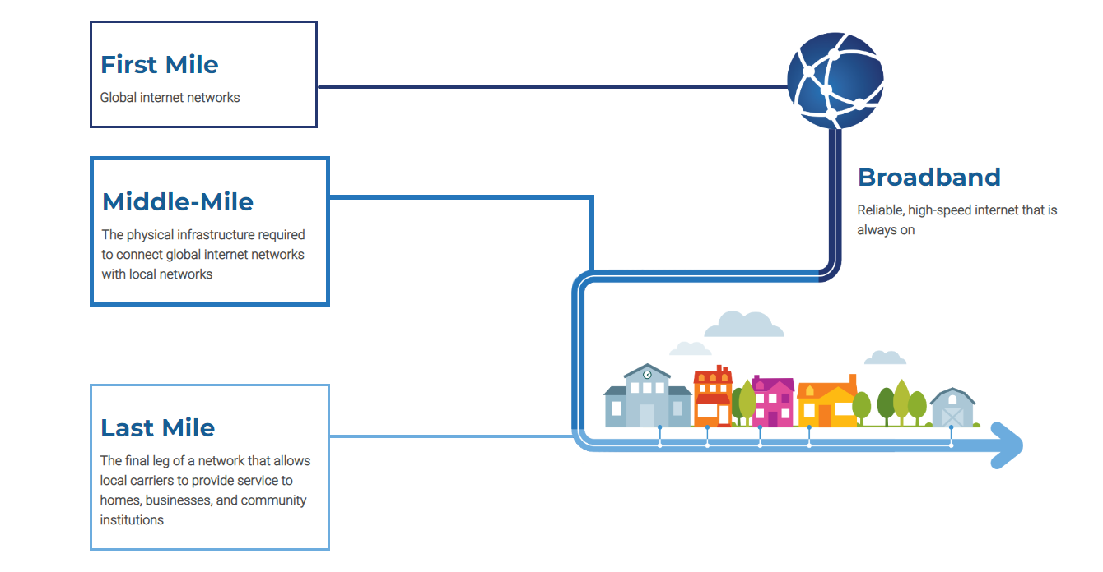
Broadband For All Infrastructure

Slide 4
Broadband For All
Access
Affordability
Adoption
Digital Equity and Inclusion

Slide 5
Scott Adams
Deputy Director Broadband and Digital Literacy
California Department of Technology

Slide 6
Broadband For All
California Broadband Council
Executive Order N-73-20
2020 Broadband Action Plan
2021 Middle-Mile Broadband Initiative

Slide 7
Broadband Initiative
SB 156 (Chapter 112, Statutes of 2021)
$6 billion investment over three years to:
Expand broadband infrastructure
Increase affordability
Enhance access to broadband for all Californians
$3.25 billion to develop, acquire, construct, maintain and operate a statewide “open-access middle-mile” network (CDT)
$2.75 billion for last-mile infrastructure grant programs (CPUC)

Slide 8
Mark Monroe
Deputy Director, Middle-Mile Initiative
California Department of Technology

Slide 9
Working together to achieve SB 156
California Department of Technology
California Public Utilities Commission
Third Party Administrator
Caltrans
Department of Finance
Program, fund management, reporting and oversight
Retain TPA
In collaboration with TPA and CPUC, facilitate high speed broadband access through last-mile connectivity
Provide data to identify unserved & underserved areas
Facilitate public comment
Recommend network placement
Manages the development, acquisition, construction, maintenance and operation of the statewide open-access middle-mile broadband network
Leverage existing transportation projects
Oversee acquisition and management of construction contracts for open-access middle-mile broadband network
Budget oversight and facilitation
State and Local Fiscal Recovery Funds (SLFRF) quarterly reporting to the federal government
Notes:
I would talk through the role of the MMAC here.

Slide 10
Middle-Mile Broadband Initiative
All construction funding committed
December 2024
November 2021 – June 2022
Caltrans
Design and
Engineering
(TPA & Caltrans)
and TPA begin
construction
or lease
Building and
operating network
Build program
CPUC obtain
Public input
August 2021
July 2022
Middle-Mile Broadband
August 2021 – December 2021
Initiative Launch,
CPUC Public
Comment Process,
Announced
Initial 18 projects
TPA Operates the network when connectivity is established.

Slide 11
Roles of partner entities per phase
Standing up Program – CDT
July/Aug to Dec 2021
Public Comments and Analysis – CPUC
Engineering & Design* – TPA & Caltrans in coordination with CPUC for last mile
*Need to be in coordination with Last Mile work by CPUC
Jan to June 2022
Initial 18 project as proof of concept
Construction or Lease to Build – Caltrans & TPA
Starting July 2022 (to be completed by end of 2026)
Construction – Caltrans
Leasing - TPA
Operating and Maintenance of MM network – TPA
Once connectivity in place (on a flow basis)

Slide 12
Expenditure Plan
Middle-Mile Broadband Initiative (MMBI)
Cumulative Expenditure Pattern
$3
,
500
$3
,
000
$2
,
500
A
v
a
i
l
a
b
l
$2
e
,
000
S
p
e
n
t
$1
,
500
$1
,
000
$500
$-
2021
2022
2023
2024
2025
2026
Notes:
Caltrans construction costs.
Lease costs for existing infrastructure.
It is expected that Caltrans will need 18 to 24 months to complete preconstruction work such as environmental review and permitting.
This project development timeline will mean that the larger construction expenditures will not be seen until 2023 through 2026.
CDT plans to encumber all of the $3.25B between 2021 and 2024, consistent with the ARPA requirements.
CDT plans to liquidate these encumbrances as projects are constructed and as lease agreements are signed.

Slide 13
Federal Funding Rules
The $3.25B MMBI project is funded entirely from American Rescue Plan Act (ARPA) funding.
ARPA funds must be encumbered by December 2024.
ARPA expenditures must be liquidated, and the MMBI project completed, by December 2026.
The $3.25B in ARPA funding is estimated to be enough to build approximately 6,000 miles of the 8,000-mile system. SB 156 provides for the remainder of the system to be developed using leases of existing infrastructure.
Notes:
Potential bullets for slides:
slide
Federal Funding Rules: The $3.25B MMBI project is funded entirely from American Rescue Plan Act (ARPA) funding.
ARPA funds must be encumbered by December 2024.
ARPA expenditures must be liquidated, and the MMBI project completed, by December 2026.
slide
Expenditure Plan: The $3.25B in ARPA funding is estimated to be enough to build approximately 6,000 miles of the 8,000-mile system. SB 156 provides for the remainder of the system to be developed using leases of existing infrastructure.
While some of the $3.25B will be used for administrative costs, the vast majority will be used for the system as follows:
Caltrans construction costs.
Lease costs for existing infrastructure.
It is expected that Caltrans will need 18 to 24 months to complete preconstruction work such as environmental review and permitting.
This project development timeline will mean that the larger construction expenditures will not be seen until 2023 through 2026.
CDT plans to encumber all of the $3.25B between 2021 and 2024, consistent with the ARPA requirements.
CDT plans to liquidate these encumbrances as projects are constructed and as lease agreements are signed.
Slide
System Design: Following PUC’s mapping analysis at the end of the year, CDT asked GoldenStateNet to develop the broader system design to inform CDT’s decisions regarding where to build and where to lease.
slide
Project Acceleration Measures: CDT is working with Caltrans on several measures to accelerate the start of Caltrans preconstruction work. These include:
Caltrans has identified 111 construction projects that lie on the anchor build route, where the construction timeframe is consistent with the federal timeframes.
Of the 111 projects, Caltrans has identified 25 that will be under construction before the end of July, for which it is currently pursuing change orders to include fiber installation.
CDT has also asked Caltrans to begin focused efforts on identifying anchor build route sections that are likely to have higher risk of complication relative to environmental challenges and the presence of utilities. This is expected to get

Slide 14
Initial Project List
The 18 initial projects – Announced in November to start pre-construction and design work as Proof of Concept:
Provide experience in geographically diverse locations
Benefit urban, rural, and tribal communities
Support earlier connectivity for several communities by connecting the core to last mile locations
Take advantage of co-build opportunities and project readiness at Caltrans
Allow us to work with GoldenStateNet, the Third Party Administrator (TPA), in exploring the mechanics of lease agreements such as Indefeasible Rights of Use (IRUs).
Notes:
Caltrans will present more information on the 18 projects later in the presentation.
These projects meet the process requirements of SB 156, including CPUC’s review.
Following the November announcement, Caltrans began its pre-construction work, which includes design, surveying, permitting, and environmental analyses.
GoldenStateNet is also reaching out to providers and operators to explore options for IRUs.
Additional projects will follow later this spring as additional analysis is completed by GoldenStateNet.
A complete map was provided by CPUC at the end of last year.
CDT is also exploring options to remediate supply-chain issues and get ahead of potential competing demand among states.

Slide 15
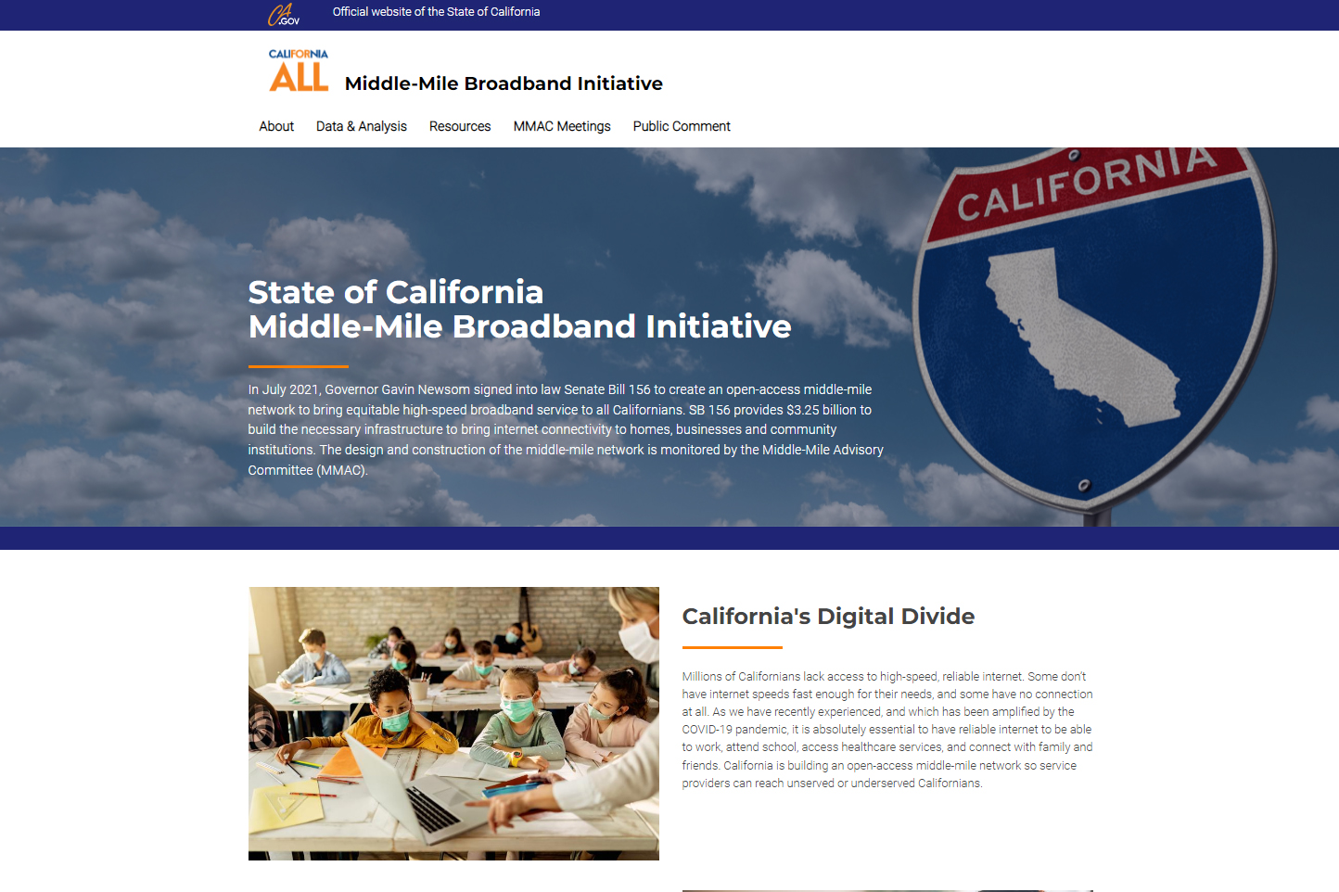
Middle-Mile Broadband Initiative Website
Since SB 156 was signed, CDT has:
Stood up the Middle-Mile Advisory Committee (MMAC).
Signed operating agreement with CPUC, Caltrans, and GoldenStateNet.
Developed, announced, and began design work on 18 initial projects that will comprise about 10 percent of the overall system.
Provided updated CPUC maps in December.
Notes:
Caltrans will present more information on the 18 projects later in the presentation.
These projects meet the process requirements of SB 156, including CPUC’s review.
Following the November announcement, Caltrans began its pre-construction work, which includes design, surveying, permitting, and environmental analyses.
GoldenStateNet is also reaching out to providers and operators to explore options for IRUs.
Additional projects will follow later this spring as additional analysis is completed by GoldenStateNet.
A complete map was provided by CPUC at the end of last year.
CDT is also exploring options to remediate supply-chain issues and get ahead of potential competing demand among states.

Slide 16
CPUC
Robert Osborn, Director of Communications Division
California Public Utilities Commission

Slide 17
2021 Broadband Investments – Background CPUC Responsibilities
Supporting Programs
California Advanced Services Fund (CASF)
~$66 million current authorized amount*
Purpose: assist with broadband infrastructure deployment and adoption in public housing, tribes, and unserved areas.
Loan Loss Reserve
$750 million total
Purpose: enable local governments and nonprofits to secure financing for broadband infrastructure.
Technical Assistance
$50 million total**
Purpose: Help prepare local governments and tribes for broadband infrastructure investments.
Middle-Mile Locations
Identify routes and priority areas using public process.
Report mapping and analysis to the California Department of Technology for use in program implementation and project development.
Last-Mile Initiative
$2 billion total
Implemented through the California Advanced Service Fund (CASF) Federal Funding Account.
Funding available for awards to applicants with broadband last-mile infrastructure projects.
* May be increased pursuant to Public Utilities Code Section 281(d)(4)
** Included in $2 billion Last-Mile Initiative

Slide 18
CPUC Role – Middle-Mile Mapping: Public Input
Over 100 organizations commented
~60 formal, 30+ informal public comments received
30+ comments for local entities (cities, counties, council of governments, local consortia and school districts)
~20 telecommunications providers (ISPs, middle-middle only providers, trade organizations representing cable and wireless industries)
20+ community-based organizations and non-profits

Slide 19
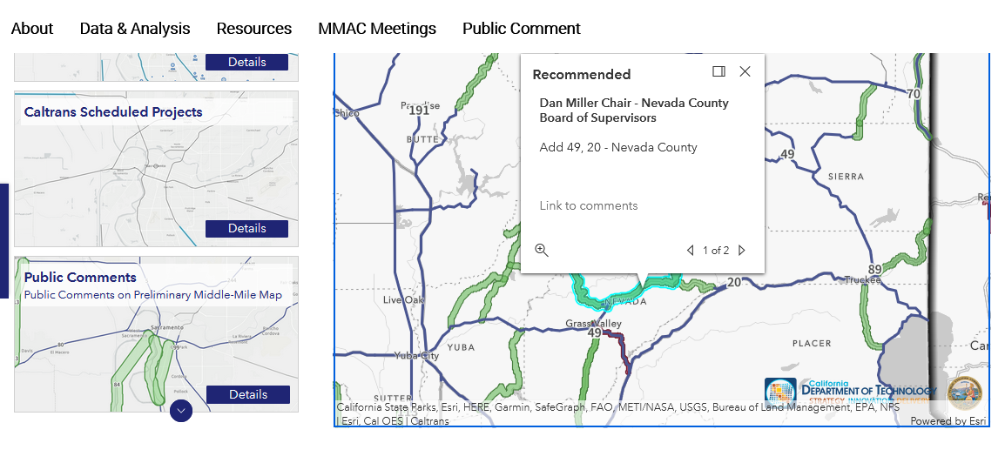
Interactive Middle-Mile Map – Example: Nevada County

Slide 20
CPUC Role – Middle-Mile Data & Analysis
Statutory Mapping Criteria – Analysis & Prioritization
Analysis Govt Code 11549.54(b)
“identify statewide open-access middle-mile broadband network locations that will enable last-mile service connections” and
“in communities where there is no known middle-mile infrastructure that is open access” and
“with sufficient capacity” and
“at affordable rates”
Prioritization Govt Code 11549.54(c) and (d)
“The commission shall identify priority statewide open-access middle-mile broadband network locations, including”:
“areas that can be built expeditiously”
“areas with no known middle-mile network access”
“regions underserved by middle-mile networks”
“regions without sufficient capacity to meet future middle-mile needs”
“locations that enable last-mile connections to residences unserved by 25 mbps downstream and 3 mbps upstream”
“may also include entities that lack sufficient high-bandwidth connections, including, but not limited to” anchor institutions, fairgrounds, and Tribal lands
Note Govt Code 11549.54(e), prioritized highways, is separate from the CPUC staff report to CDT

Slide 21
CPUC Role – Middle-Mile Location Development Timeline
90 day public comment period in statute ends
CPUC collects and analyzes additional data request to broadband middle-mile network providers
CPUC concurs with Initial Project locations
Legislature passes and Governor Newsom signs SB 156
CPUC releases 2 Rulings on project locations, routes, and network characteristics
Solicits both formal and informal public comments
CPUC, in coordination with CDT, releases additional analysis, maps, and data
CPUC, in coordination with CDT, releases additional analysis, maps ,and data
CPUC shall update mapping data from time to time
July 2021
August-September 2021
Oct-Nov 2021
Dec 2021-January 2022
February-March 2022
2023-2024
CPUC Broadband Infrastructure Deployment Proceeding (R. 20-09-001)
Formal public process and venue for developing and updating middle-mile mapping analysis and data
Also serves as the public forum for developing rules for the last-mile program.

Slide 22
Golden State Net
California Broadband Middle-Mile Initiative, LLC
Tony Naughtin - President and Chief
Operating Officer, Golden State Net

Slide 23
GoldenStateNet is Born
Where possible, GoldenStateNet could leverage existing CENIC Internet backbone and services as well as its direct peering relationships with Internet, Cloud and Content Service Providers.
The project will build upon CENIC’s existing key partnerships and twenty-five years of experience.
The organization works closely with project partners CDT, California Public Utilities Commission (CPUC), Caltrans.
GoldenStateNet began official operations as of September 1, 2021 and is working expeditiously to deliver on the promise of bringing broadband equity to all Californians.

Slide 24
GoldenStateNet – Initial 18 Projects
Work underway on:
Route planning and design specifications (per project location).
Coordination with Caltrans and its contractors and suppliers on new-builds.
Negotiation for Dark Fiber Indefensible Right of Use (IRUs) in locations where that is part of the initial development approach decided upon.
Determination of Regional Exchange Points within these projects

Slide 25
Statewide Work: In Progress
Planning the statewide middle-mile open access-network design, including interconnection needs with other networks
Finalizing Program Plan and developing potential service offerings
Regional Exchange Points, beyond initial projects
Continued partnership and collaboration with CDT, Caltrans and CPUC

Slide 26
Caltrans
Janice Benton
Division Chief, Division of Design
California Department of Transportation

Slide 27
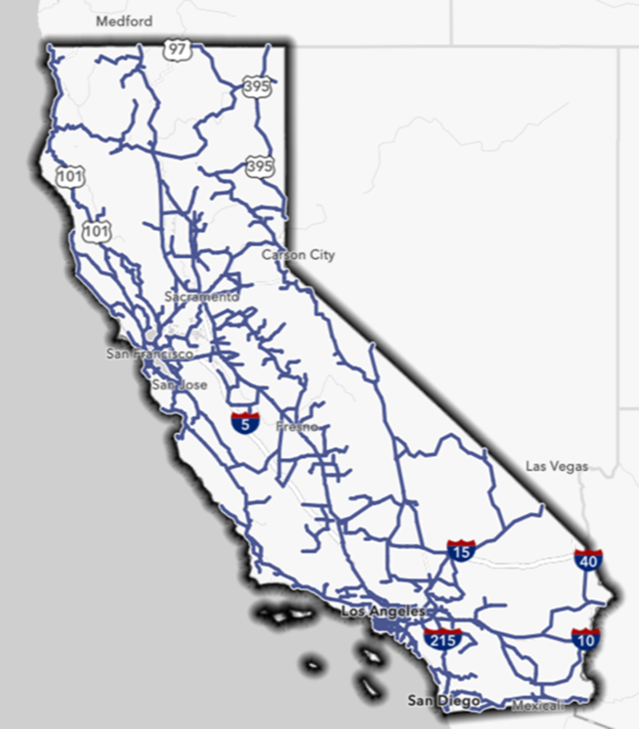
Collaboration
CPUC identified Middle-Mile Broadband Network
Dept. of Technology identifies highway project locations
Caltrans builds at highway locations

Slide 28
Caltrans’ Role
Initial project locations
Build on state highways via:
Highway projects in construction
Highway projects to be constructed in next 3 years
New stand-alone projects
Notes:
CDT and CPUC have identified 8100 miles as the viable miles to add the BMMN work to. They decides where to build. We need it by next couple of months. We have been meetings with them. CPUC has a public comment period for feedback on those 8100 miles.
$455k per mile estimate was given based on CT projects. We will have better idea after first few projects.
For the project initiation approval request, we can use the following unit price to estimate the project cost:
1). $350,000 per mile of conduit- capital construction and R/W costs
2). $105,000 per mile of conduit- for support costs (PA/ED, Design, R/W support, Construction Support)
Caltrans priority is to knowing these locations and Design details, Size and # of conduits/fiber/Strands, specs,
We have been given funding of $3.25 bill, which may not be enough for the 8100 miles of priority locations. We have shared that with CDT that initial estimates may be just average.
CDT is the lead on selecting the locations and who builds them.
This map is internal to CT. We don’t want to share this externally, because we don’t want to be lead, we are partners to CDT and CPUC.
Russ Walker has help developed it.

Slide 29
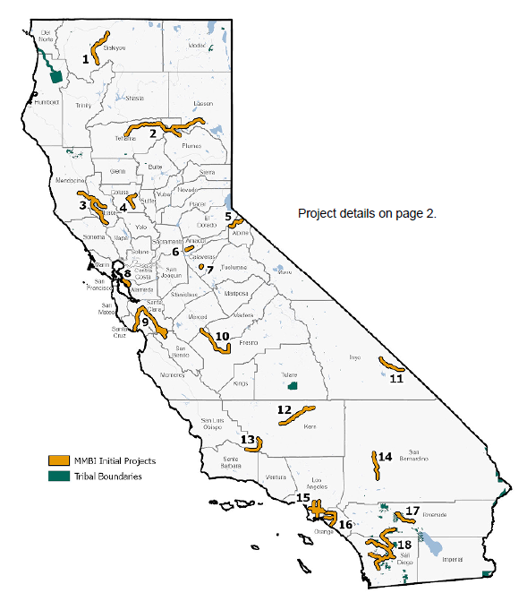
Initial Project Locations
Caltrans building at 14 of these locations
Dig once on existing highway projects
New projects

Slide 30
Dig Once
Reviewing existing highway projects for viability
Narrowed to about 100 highway projects for deeper feasibility analysis
Covers about 700 miles

Slide 31
Delivery Strategy
Work on state highway locations identified
Funding deadlines:
By 2024: Enter into all construction contracts
By 2026: Expend all funds
Sequence work based on challenge areas
Streamline permitting
Project delivery tools

Slide 32
What’s Next
CDT is moving forward with a competitive procurement of 3,000 miles of fiber and related materials by the first week in March.
CDT will deliver the SB 156 status report to the Legislature by March 1st.
Updated system information recommendation of sequency of work on statewide network in April.
Finalized design of network by July.
Fiber to be included in a dozen existing transportation projects that will be in construction by July.
Fiber to be included in another 80 plus projects that are currently in the preconstruction phase.
Preconstruction to begin on 6,000 miles of constructed segments between now and July.
Anticipate seeing projects in construction as soon as 2023.
IRUs and lease agreements to follow.

